Slide 1
Targeted attack stages and AV detection methods in terms of Ripter APT
Valery Slezkintsev

Slide 2

What is APT?
A – Advanced
P – Persistent
T – Threat

Slide 3
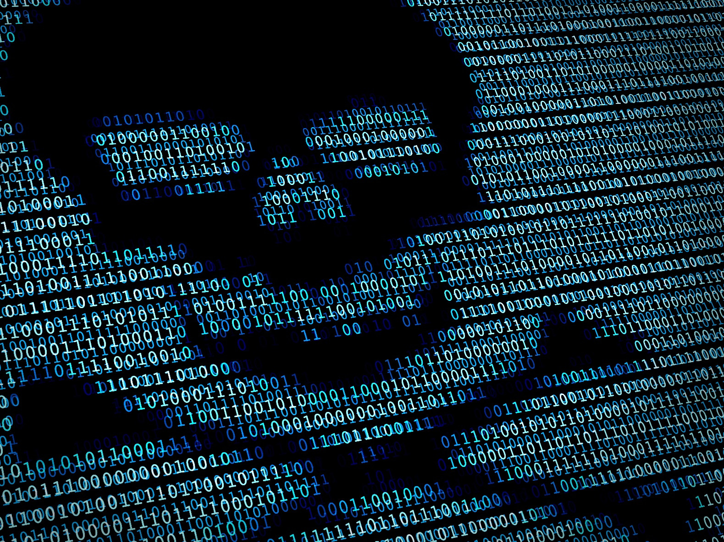
Examples
Stuxnet
DUQU
Carbanak
Ripter
…

Slide 4
Is it possible to be protected?
Some general rules:
Security awareness
Penetration tests
Regular updates
Backup
Antimalware protection

Slide 5

Targeted attack kill chain
Mail
Mail
Network
Infected USB
Network
Preparation
Penetration
Propagation
Execution
Incident

Slide 6





Information gathering
Passive
Active

Slide 7

Network penetration
Vulnerable software
Phishing
Weak passwords
Server misconfiguration

Slide 8
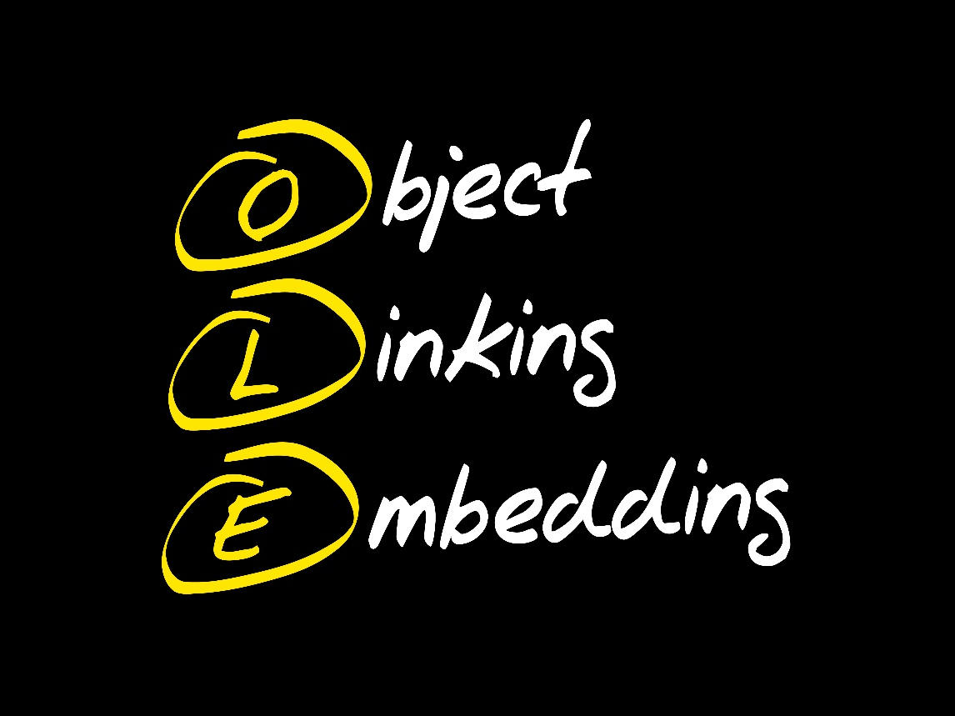



Network penetration
CVE-2012-0158
CVE-2014-6352

Slide 9



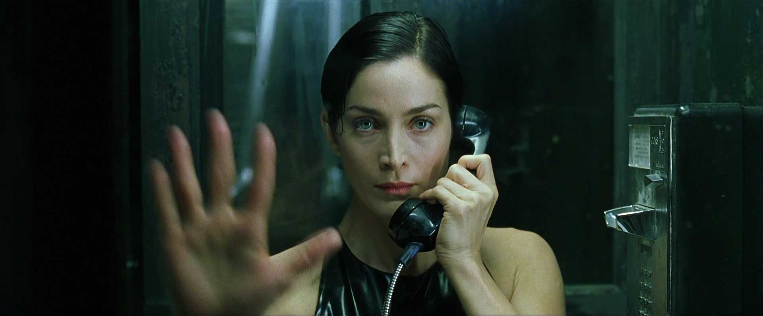
Typical actions
Downloading additional files
Getting system/root privileges
Starting rootkit
Call back to C&C

Slide 10

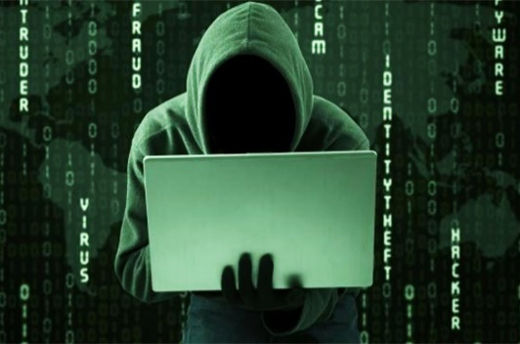
Ripter’s killchain
Phishing ppt
Target
C&C
Putty.exe
Drv1028.sys
srvlic.dll/msfte32.dll/msfte.dll
Run.dat

Slide 11



Lateral movement
Target
C&C

Slide 12
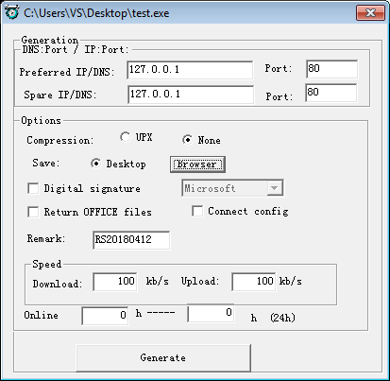
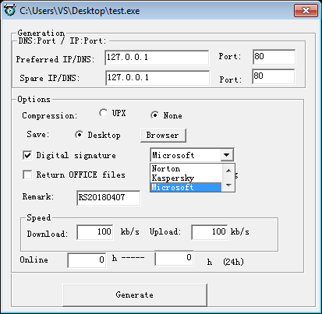

Builder

Slide 13
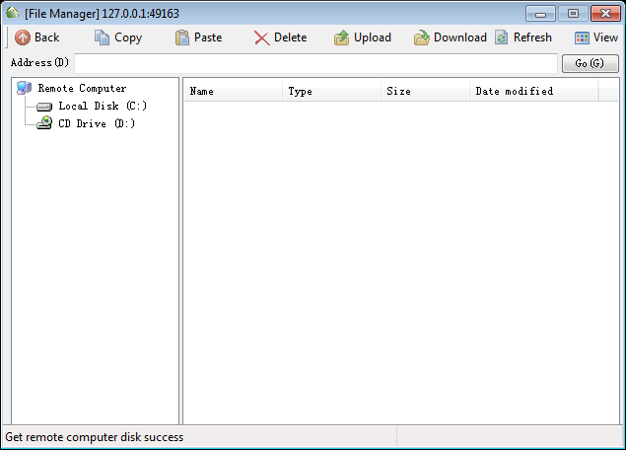
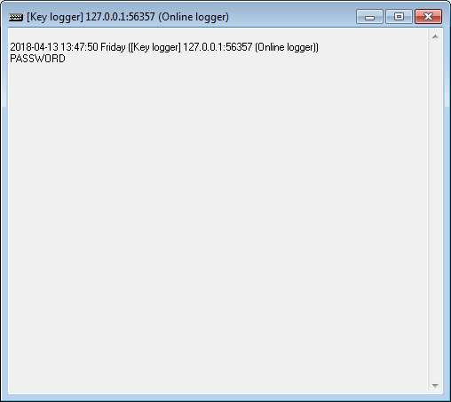
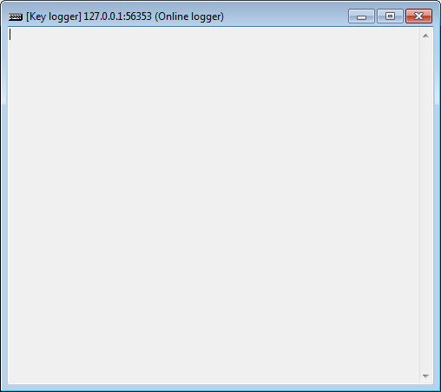
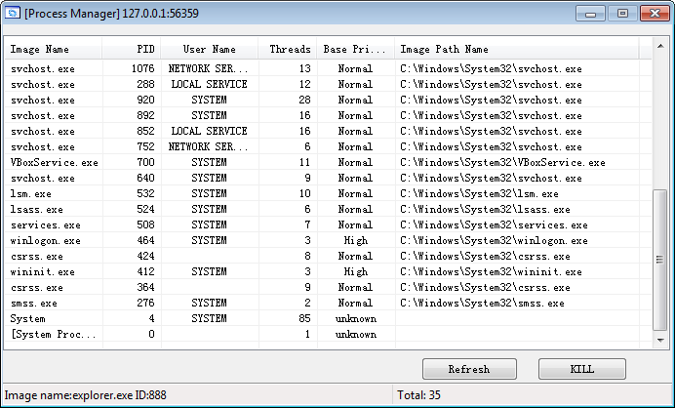
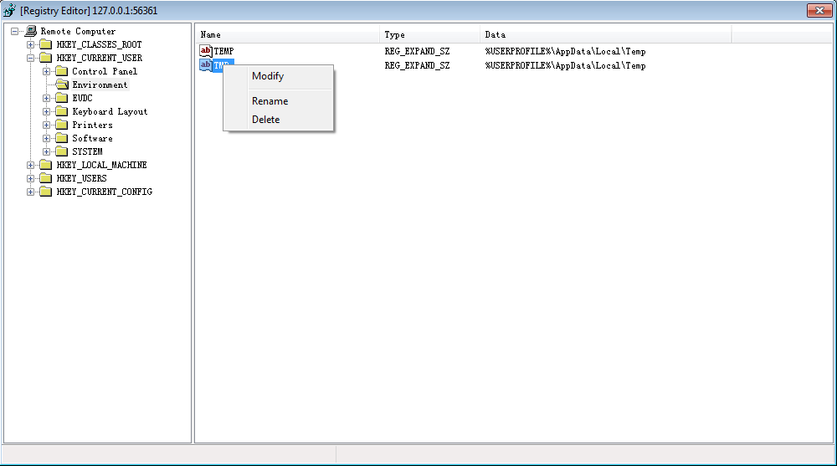
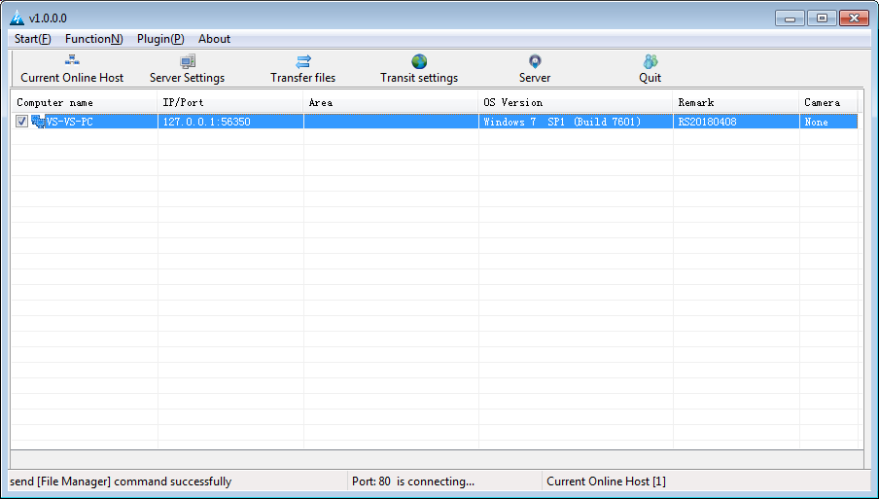
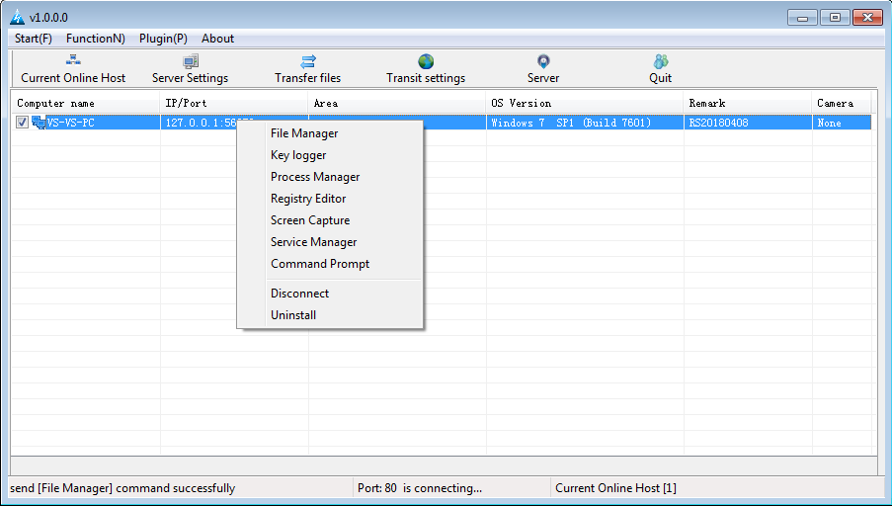
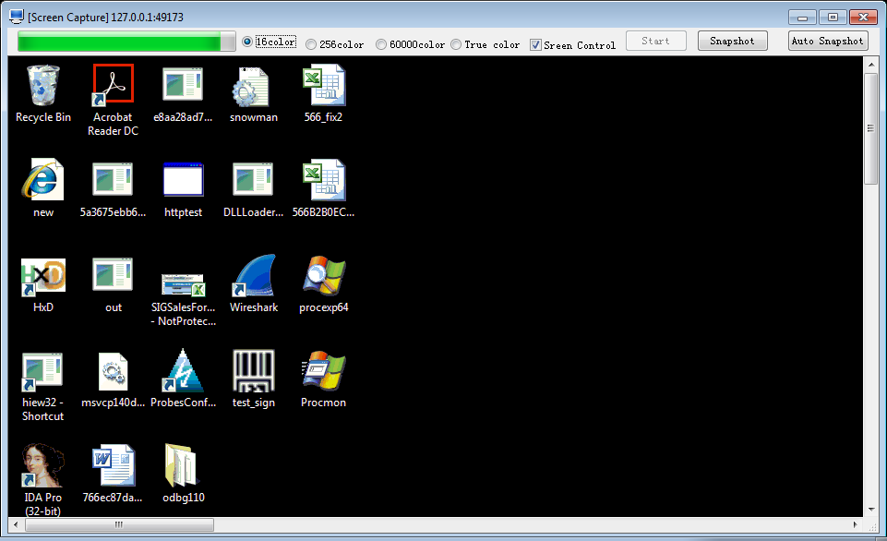
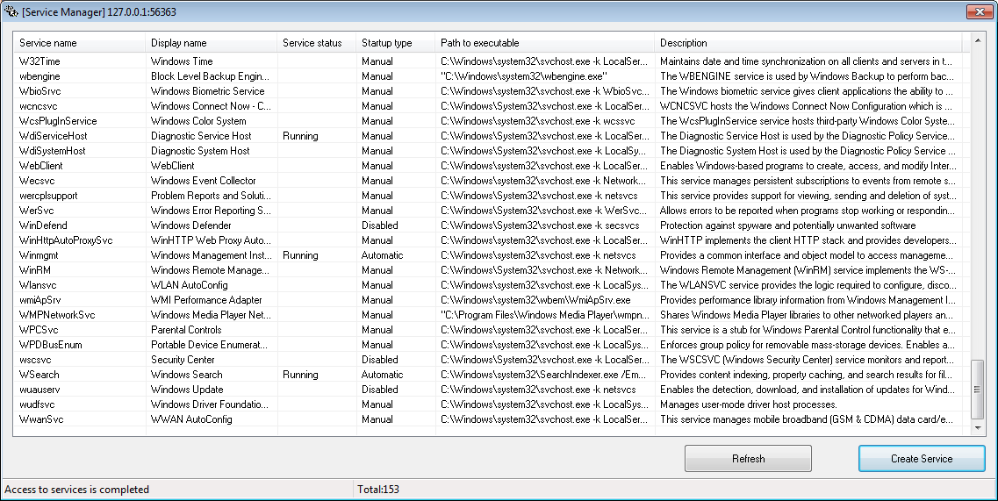
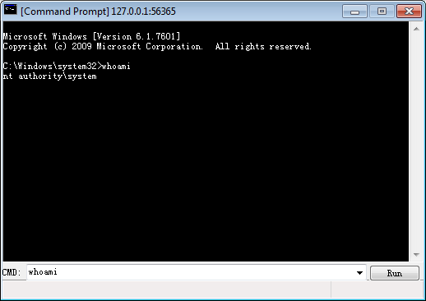
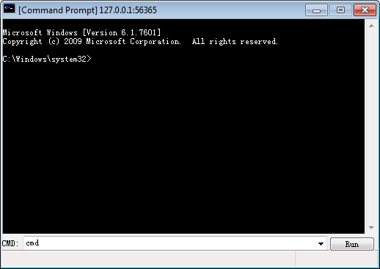
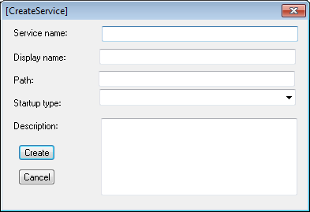
Administration tool

Slide 14

Remember
Do not turn macroses on
Do not click on suspicious objects
Use antivirus
Configure user account policy
Use password manager

Slide 15

AV Detection

Slide 16

Highlevel structure of EPP
EPP – Endpoint Protection
Bases
Engine

Slide 17
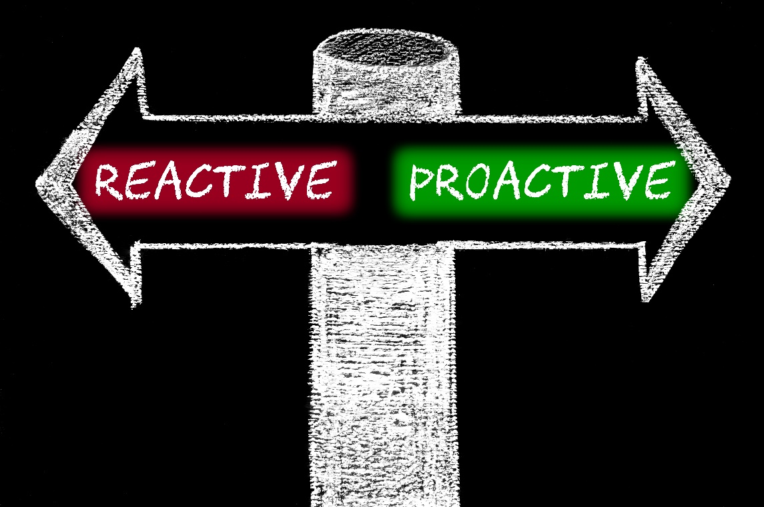
AV detection
Signatures
Hashes
URL filter
Emulation
Sandbox
Behavior based detection

Slide 18
Reactive detection
Signatures

Slide 19
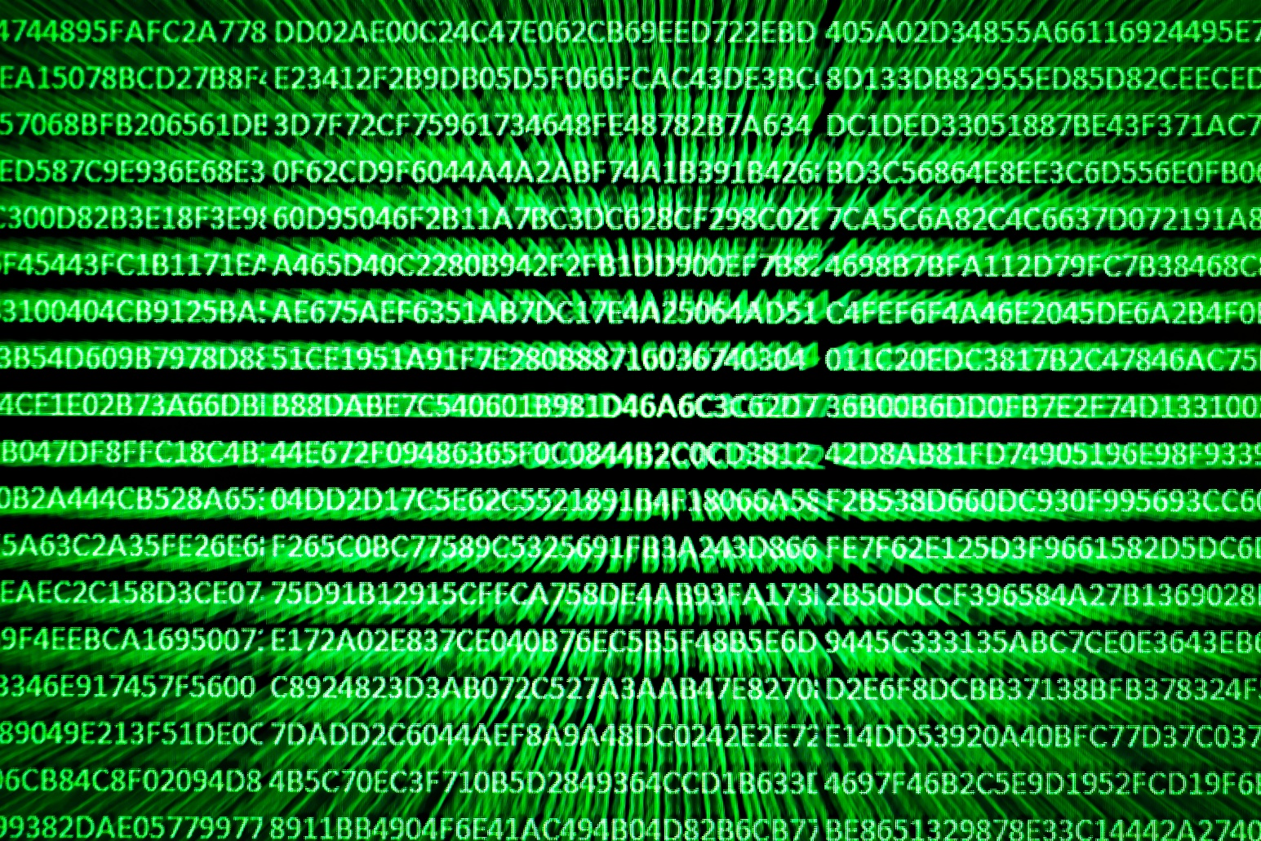
Reactive detection
Detection by hash

Slide 20

Proactive detection
Emulation

Slide 21
Proactive detection
Object sent to sandbox
Object detonated in virtual environment
Sandbox
Verdict returned to user
Activity in virtual environment monitored

Slide 22
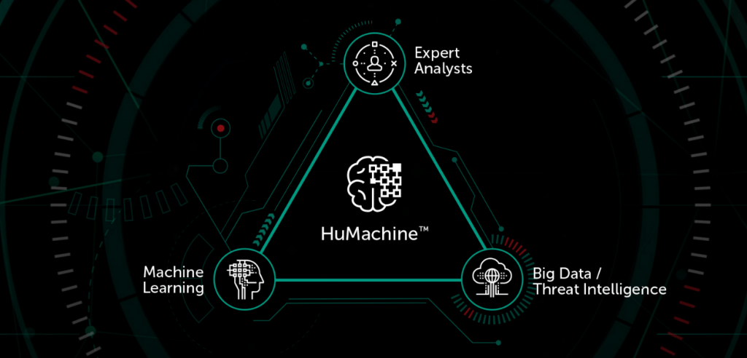
Machine Learning
Big data + Experts = Machine Learning

Slide 23
Detection summary
Reactive
Proactive
Fast
Low probability of false alarm
Low system requirements
Detects new malware
Persistent detection

Slide 24

Let’s kill the Ripter!

Slide 25
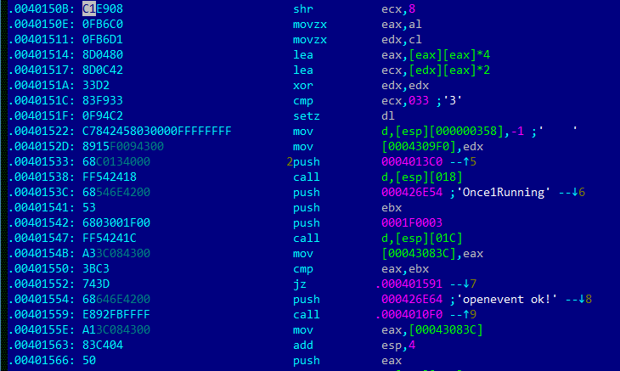
Ripter detection
Signature for putty.exe
MD5: f29f874dea11474a45854284491eb913

Slide 26
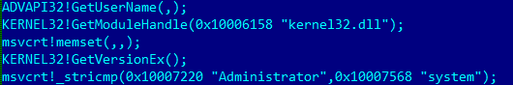
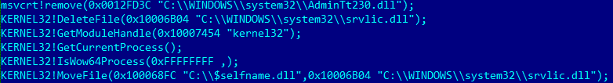
Ripter detection
Emulation log for msfte.dll
MD5: eac1e9256f9ad041efb2f50e1e25c96b

Slide 27
Ripter detection
Interesting strings in memory dump:

Slide 28
Ripter detection
IF(
“stricmp(%parent_process%,’winlogon.exe’)” IN LOG
AND
“stricmp(%parent_process%,’rundll32.exe’)” IN LOG
AND
“OpenEvent(,,’Once1Running’);” IN LOG
)
OR
(
“stricmp(%username%,’system’)” IN LOG
AND
“cmd.exe /c sc stop MpsSvc && sc config MpsSvc start= disabled” IN DMP
)
OR
“Trojan: END NOW!” in DMP
)
throw_verdict(“Backdoor.Win32.Ripter”)

Slide 29
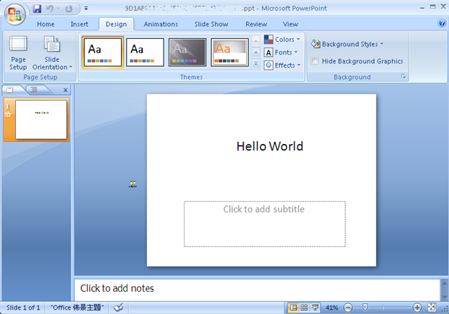

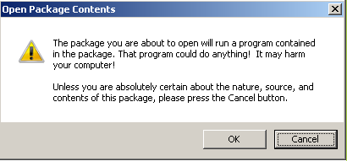
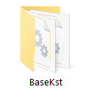
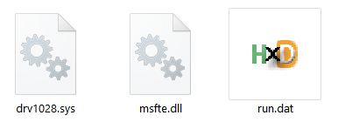
Ripter detection
Sandbox detection for phishing.ppt
MD5: 9D1AF0141067250FCEFEFEB230985A0C

Slide 30
Ripter detection
// -------putty.exe was dropped on disk---------
CreateFileW ("%Temp%\\putty.exe")
WriteFile ("%Temp%\\putty.exe")
//------------------putty.exe launched-----------------
ShellExecuteExW ("%Temp%\\putty.exe")
//------Directory created with malicious files
CreateDirectoryA ("C:\ProgramData\BaseKst”)
CreateFileA ("C:\ProgramData\BaseKst\drv1028.sys")
WriteFile ("C:\ProgramData\BaseKst\drv1028.sys ")
CreateFileA ("C:\ProgramData\BaseKst\run.dat")
WriteFile ("C:\ProgramData\BaseKst\run.dat ")
CopyFileA ("C:\ProgramData\BaseKst\run.dat", "C:\ProgramData\BaseKst\msfte.dll")
//------------check if firewall exists-------------
GetModuleHandleA ("BkavFirewallEngine.dll")
//------------backdoor execution----------------------------
LoadLibraryA ("C:\ProgramData\BaseKst\msfte.dll")

Slide 31
Ripter detection
//-----------checks if it is a system process
_stricmp (%username%, "system")
//-----------------Desktop created------
CreateDesktopA ("KST_106")
//------------backdoor initialization----------------------------
CreateProcessA ("cmd /c rundll32 \"C:\ProgramData\BaseKst\msfte.dll\", Rundll32Call")
//------------checks if another copy was already executed---
OpenEventA ("Once1Running")
//------------move to system32-------------------------
MoveFileA ("C:\ProgramData\BaseKst\msfte.dll","C:\Windows\system32\msfte.dll")
//------------C&C communication-------------------
CreateProcessA ("rundll32.exe \"C:\ProgramData\BaseKst\run.dat\", Rundll32Call")
//------------rootkit communication-------------------------
CreateFileW (\\.\My_Symobliclink)
//------------Waiting for commands from C&C----------
WSAStartup ()
socket ()
gethostbyname ("www.******.****.ms")
send ("\05\10")
recv()

Slide 32
Ripter detection
IF(
(
(
“CreateDirectoryA (\"C:\ProgramData\*”)” IN LOG
AND
“GetModuleHandleA (\"BkavFirewallEngine.dll\")” IN LOG
)
OR
(
“OpenEvent(\“Once1Running\”)” IN LOG
AND
“CreateDesktopA (\"KST*\")” IN LOG
)
)
AND
“CreateProcessA ("rundll32.exe \"C:\ProgramData\*\", Rundll32Call\")”
)
throw_verdict(“Backdoor.Win32.Ripter”)

Slide 33

Thank you for your attention! Kaspersky Lab HQ 39A/2 Leningradskoe Shosse Moscow, 125212, Russian Federation Tel: +7 (495) 797-8700 www.kaspersky.com valery.slezkintsev@kaspersky.com

